Slide 1
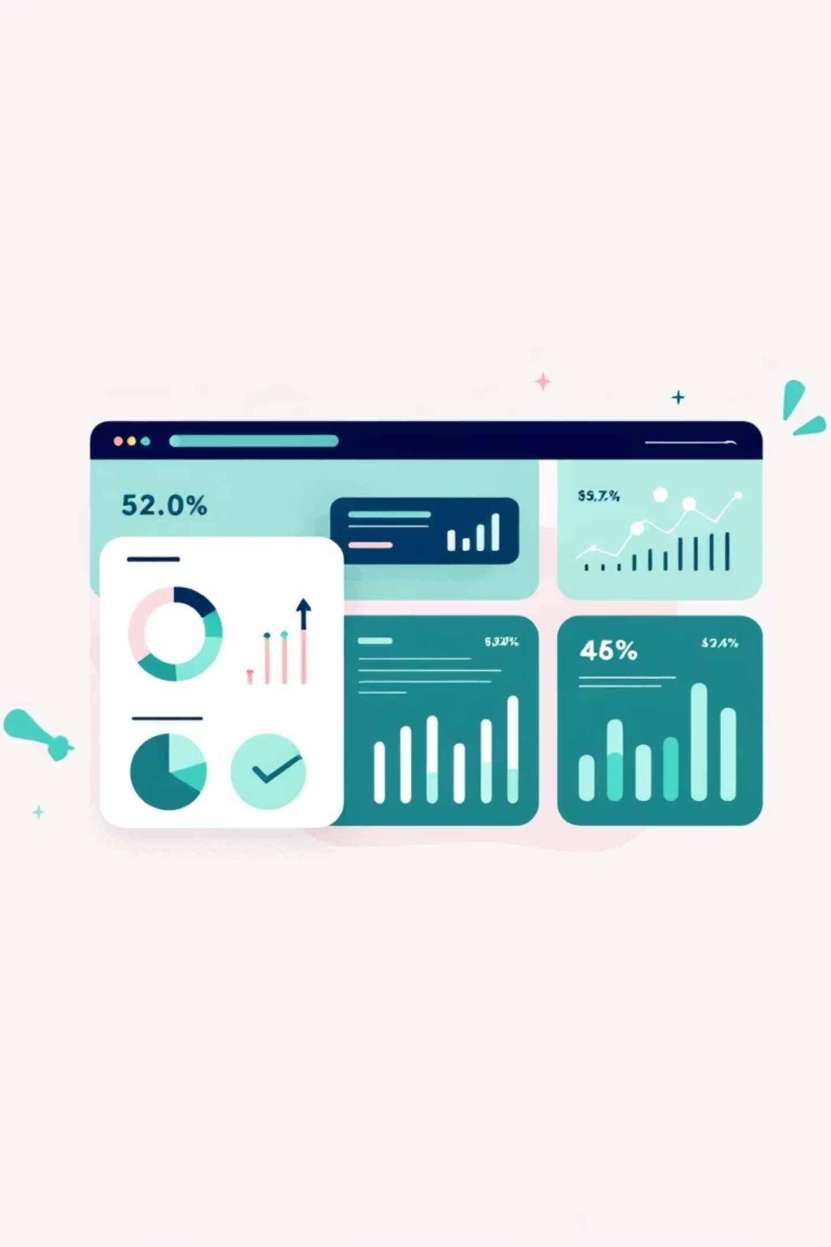
Customer Shopping Behaviour Analysis
Analysing 3,900 purchases to uncover spending patterns, customer segments, and strategic insights for data-driven business decisions.

Slide 2

DATASET OVERVIEW
The Data Behind the Insights
3,900
18
50
Total Purchases
Data Points
Locations
Features per customer transaction
Geographic coverage
Transactions analyzed across multiple categories
25
Products
Unique items tracked

Slide 3

PYTHON ANALYSIS
Data Preparation & Cleaning
01
02
Data Loading
Missing Data
Imported dataset using pandas, explored structure with df.info() and summary statistics
Filled 37 missing Review Rating values using median rating per product category
03
04
Feature Engineering
Database Integration
Created age_group and purchase_frequency_days columns for deeper analysis
Connected to MySQL and loaded cleaned data for SQL analysis

Slide 4

SQL ANALYSIS
Key Business Questions
Revenue Analysis
Customer Behavior
Gender-based revenue comparison
Subscriber vs. non-subscriber spend
High-spending discount users
Customer segmentation analysis
Revenue by age group
Repeat buyers & subscriptions
Product Performance
Operations
Shipping type comparison
Top 5 products by rating
Discount strategy effectiveness
Top 3 products per category
Discount-dependent products

Slide 5
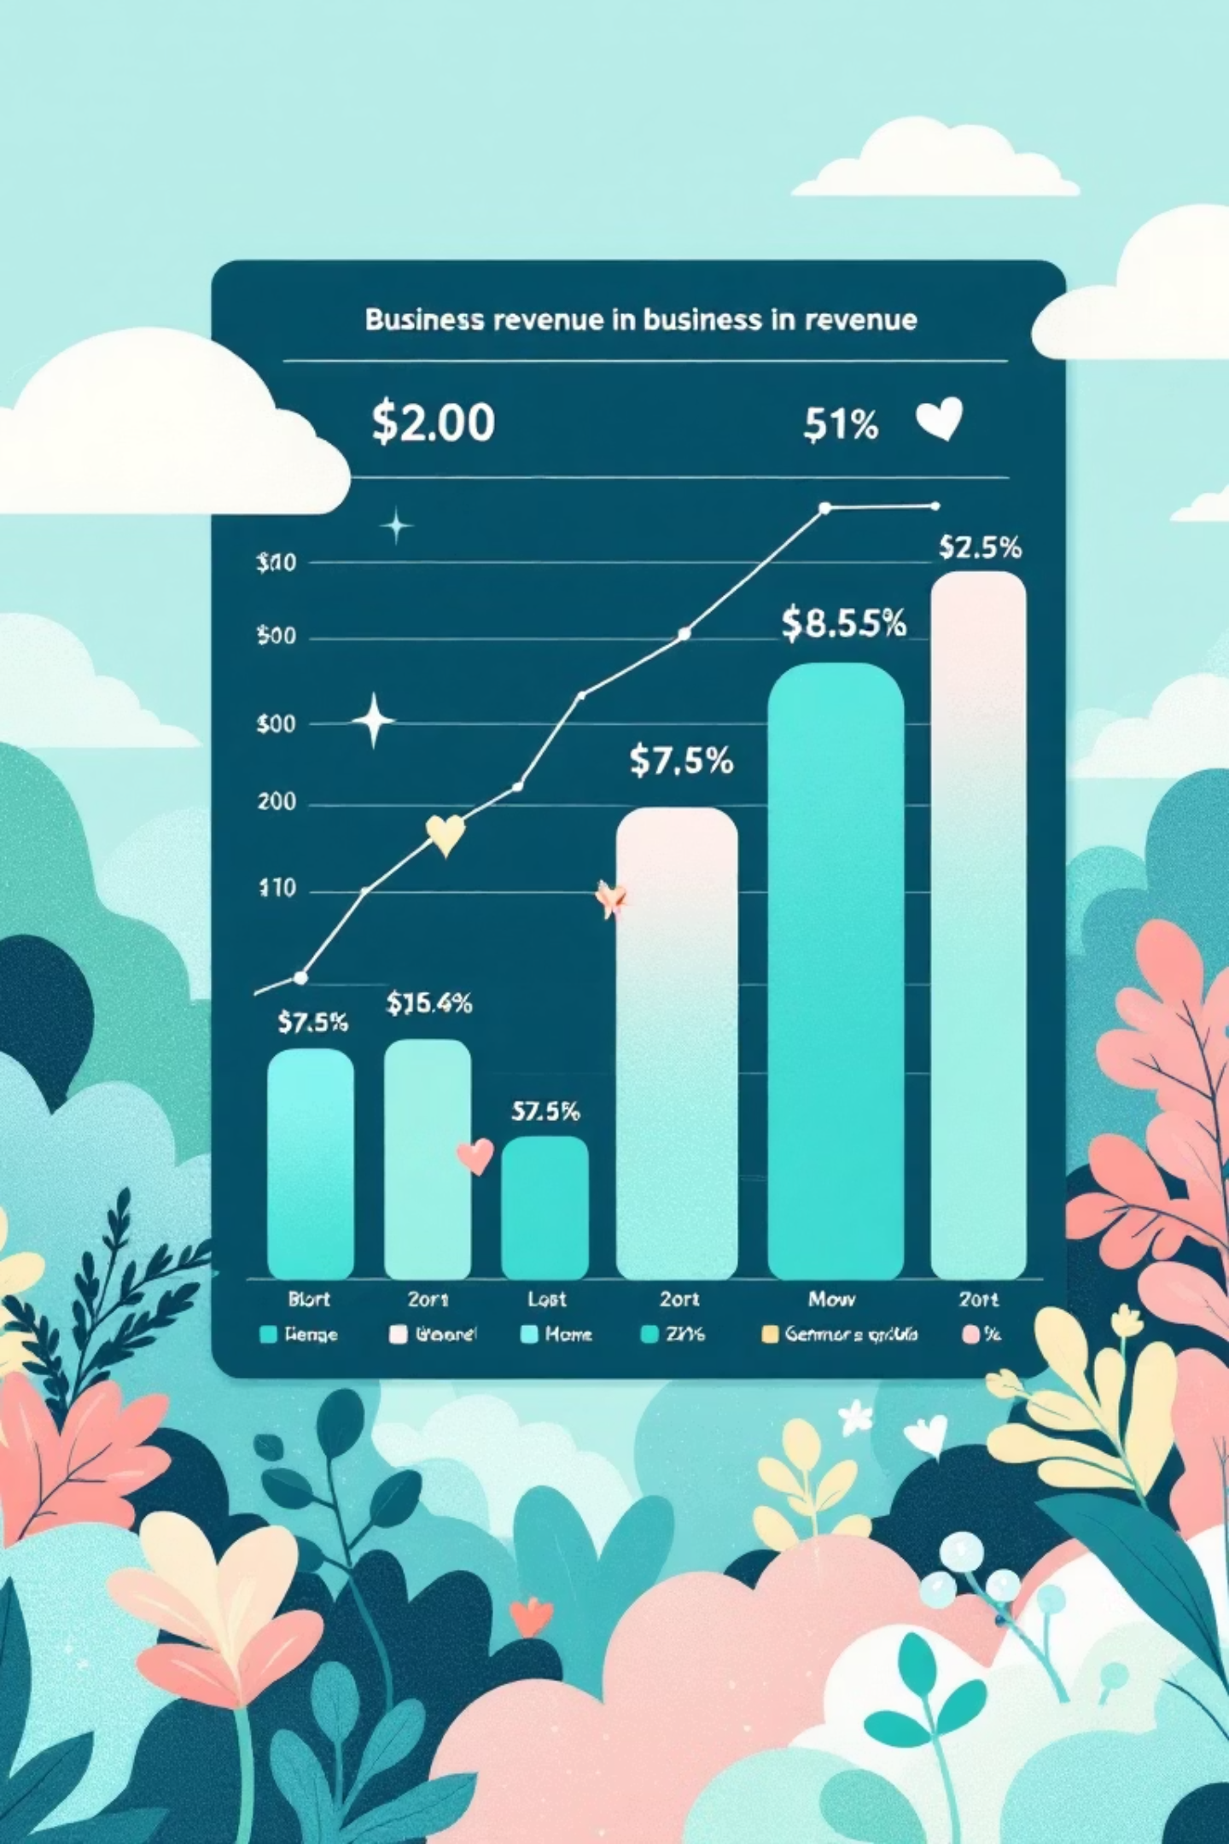
Revenue Insights
Male Customers
$157,890 total revenue
Significantly higher spending power
Female Customers
$75,191 total revenue
Opportunity for targeted growth
Express Shipping
Standard Shipping
Premium shipping correlates with higher spending
$60.48 avg purchase
$58.46 avg purchase

Slide 6
PRODUCT PERFORMANCE
Top-Rated Products
96%
95%
94%
Gloves
Sandals
Boots
3.86 average rating - highest performer
3.84 average rating
3.82 average rating
93%
92%
Hat
Skirt
3.80 average rating
3.78 average rating

Slide 7



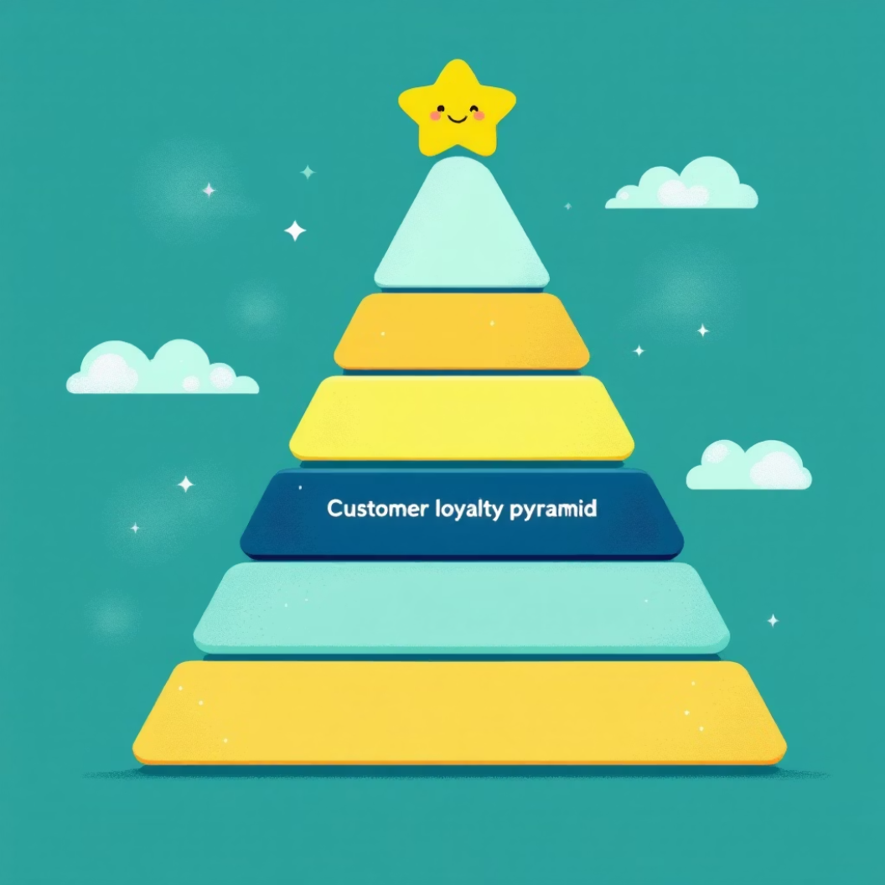
Customer Segmentation
Loyal
3,116 customers
Returning
701 customers
New
83 customers
Strong loyal customer base represents 80% of total customers
958 repeat buyers with subscriptions vs. 2,518 without

Slide 8
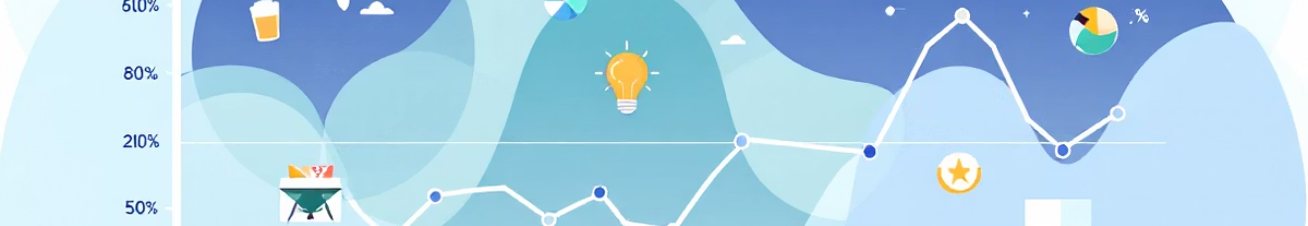

SUBSCRIPTION ANALYSIS
Subscribers vs. Non-Subscribers
Subscribers
Non-Subscribers
1,053 customers
2,847 customers
$59.49 average spend
$59.87 average spend
$62,645 total revenue
$170,436 total revenue
Similar spending patterns suggest subscription benefits need enhancement to drive conversion

Slide 9

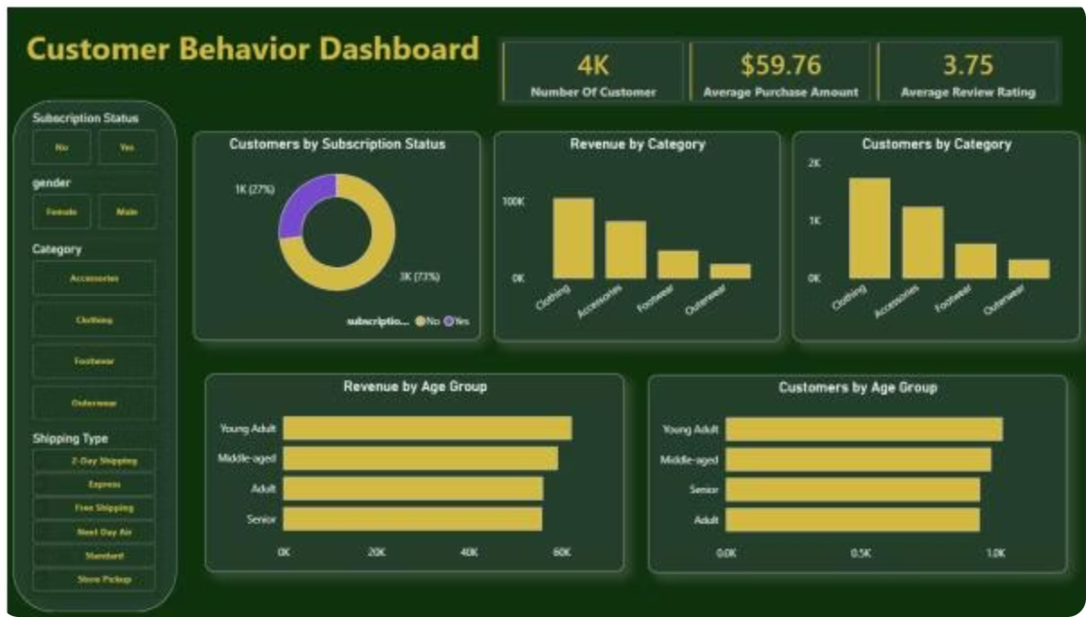
POWER BI DASHBOARD
Interactive Analytics Dashboard
4K
$59.76
3.75
Customers
Avg Purchase
Avg Rating

Slide 10



RECOMMENDATIONS
Strategic Business Actions
Boost Subscriptions
Loyalty Programs
Offer exclusive benefits to convert non-subscribers
Reward repeat buyers to increase retention
Optimize Discounts
Balance promotions to maintain profit margins
Promote Top Products
Feature high-rated items in campaigns
Targeted Marketing
Focus on high-revenue age groups and express shipping users

